Slide 1
Black Liberation Theology
Notes:
Emory & Henry College Lyceum, February 2017

Slide 2
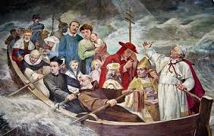
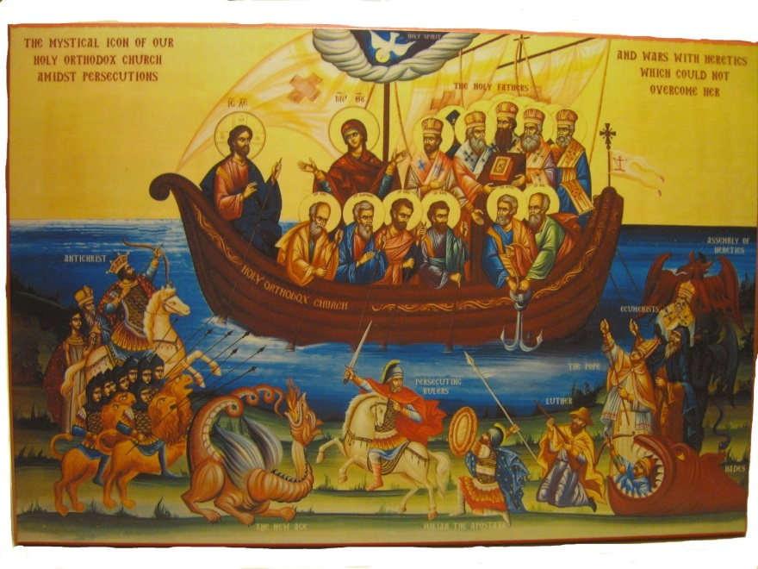
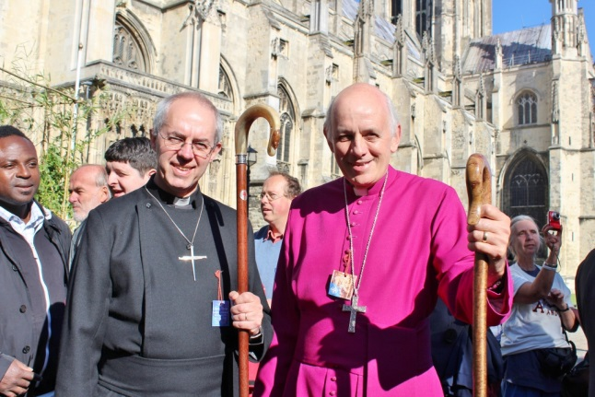
Church and Society
The Church as the Arc of Salvation
Augustine’s City of God
Pilgrims and Cathedrals

Slide 3
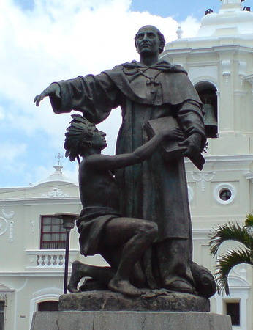
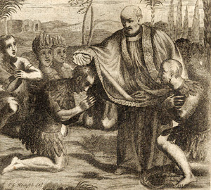

Mater et Magistra
Influencing society through elites
Bartolomé de las Casas
Schools

Slide 4

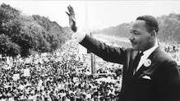
Christ Immersed in the World
For a more just society, 1963
Vatican II and Pacem In Terris
“I Have a Dream” speech

Slide 5
A New Way of Doing Theology
What is theology?
Merriam-Webster defines theology as the study of religious faith, practice, and experience; especially, the study of God and of God's relation to the world.
Liberation Theology, however, defines theology as the critical reflection on praxis in light of the Word of God. The emphasis is not on study or theory but on action informed by study. What does it mean to be a Christian in a context of social injustice? How should the Church act?

Slide 6

Theology as Praxis
Theory + Action Theology as the process by which the Word of God is enacted and realized in the World.
Reflection from the point of view of the Word of God leads to new action with further reflection.

Slide 7
Late 1960s / Early 1970s
Liberation Theology arose independently in Latin America among Roman Catholics and in the United States among African American Protestants.

Slide 8
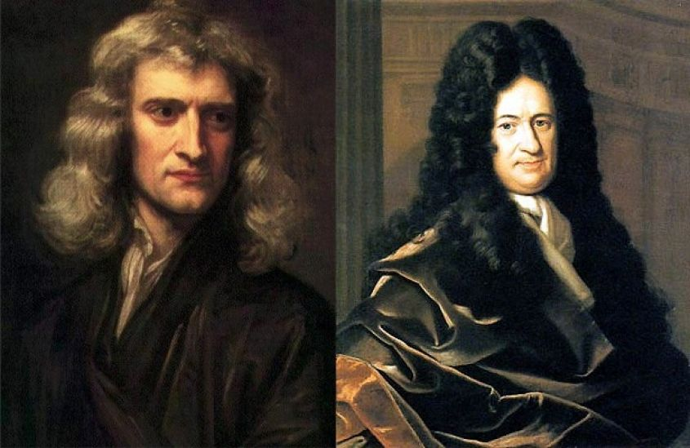
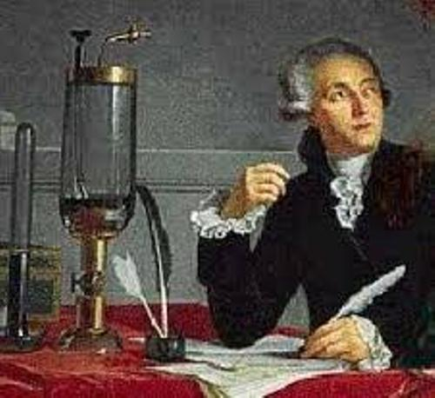
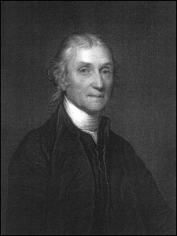
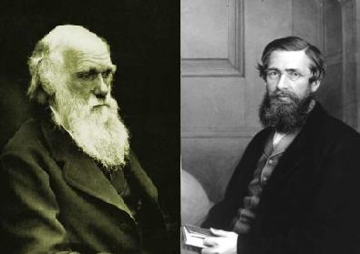
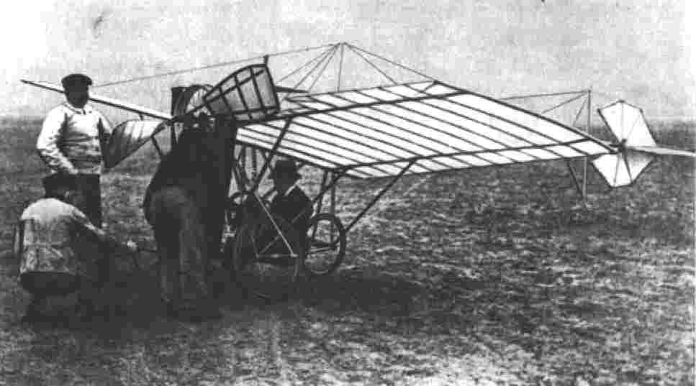
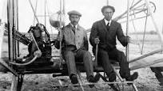
The Time Was Right

Slide 9
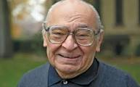
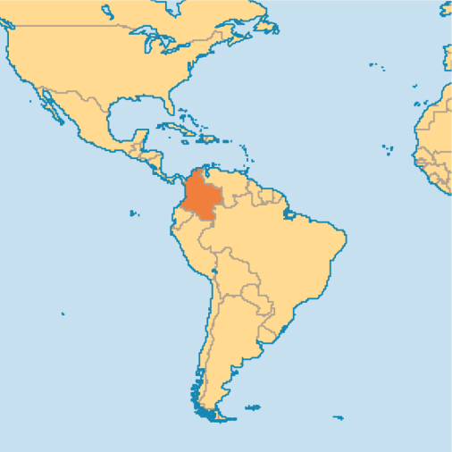
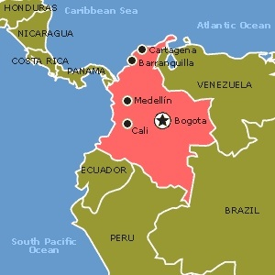
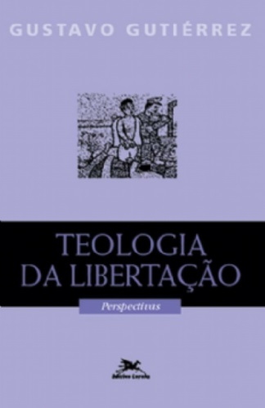
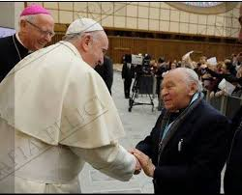
CELAM II and Gustavo Gutiérrez
1968 Medellín Conference
Council of Latin American Bishops
Teología de la Liberación, 1972

Slide 10
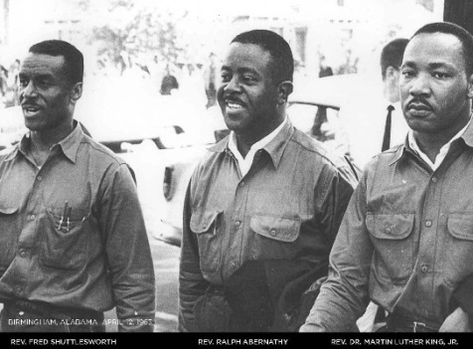
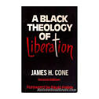
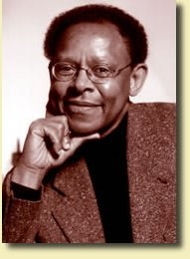
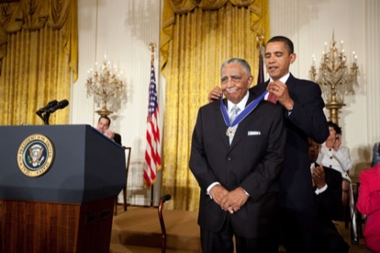
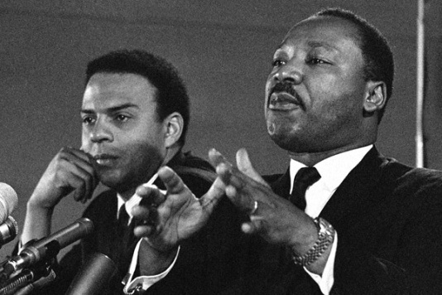
Civil Rights and James Cone
The Civil Rights Movement
African American Ministers
A Black Theology of Liberation, 1970

Slide 11
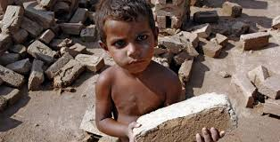
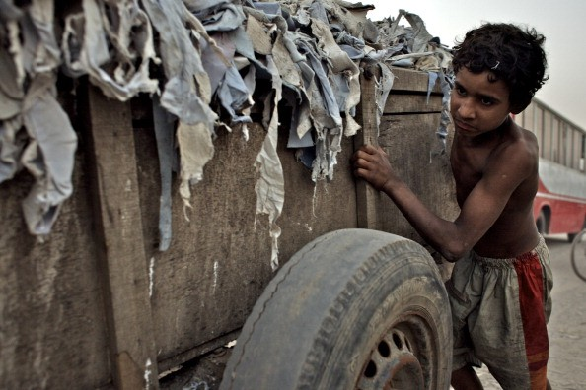
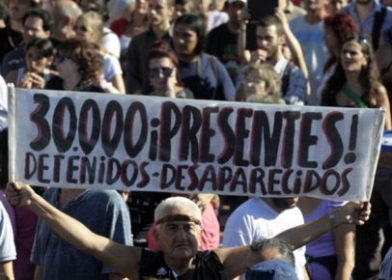
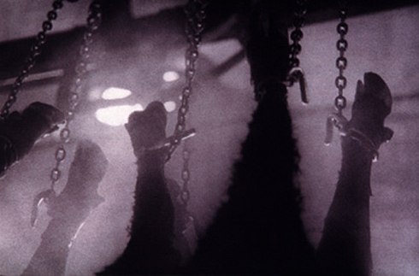
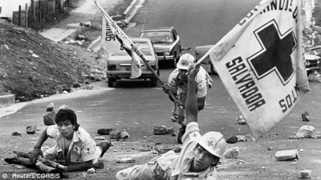
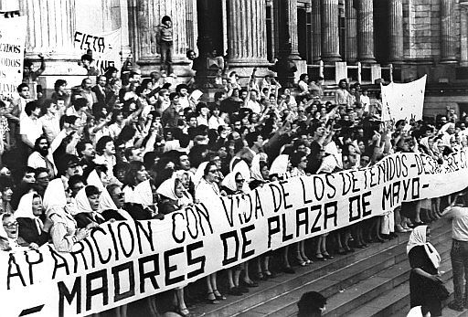
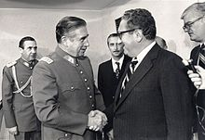
Speak for Oppressed Peoples
Neo-colonialism
Massive poverty
Landless peasants
Ruthless dictatorships
Civil wars
Torture
Desaparecidos

Slide 12
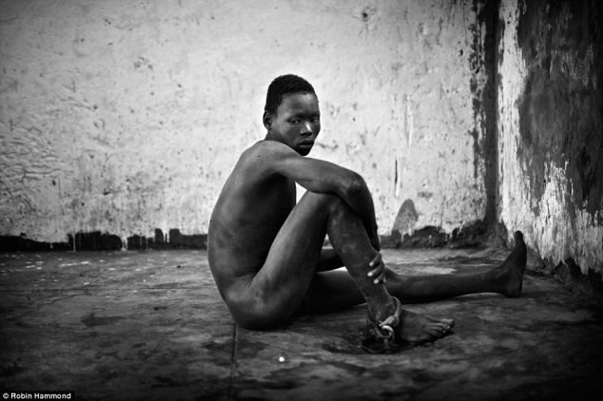
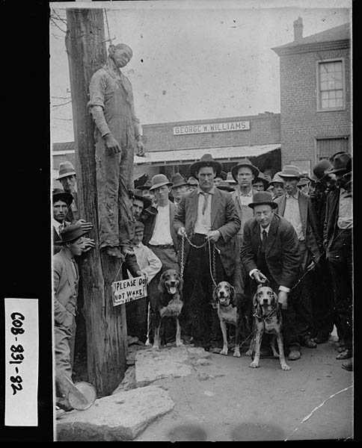
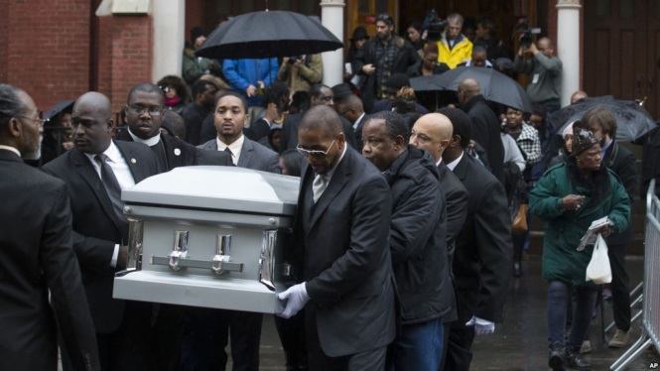
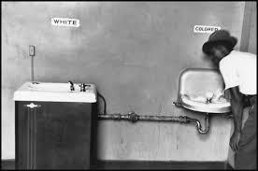
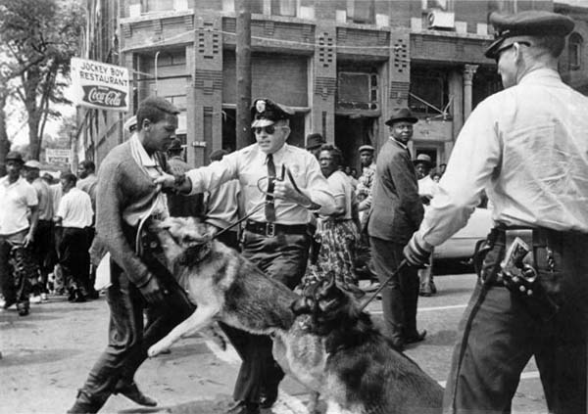
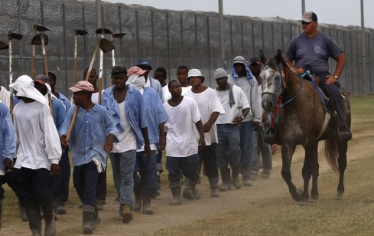
For African Americans Let’s Add
History of slavery
Lynching
Segregation
Police Brutality
Racism

Slide 13
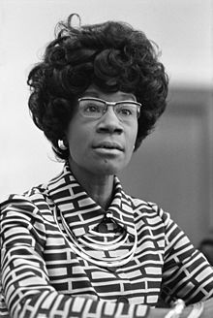
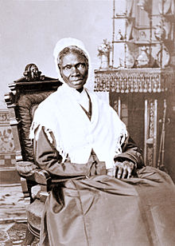
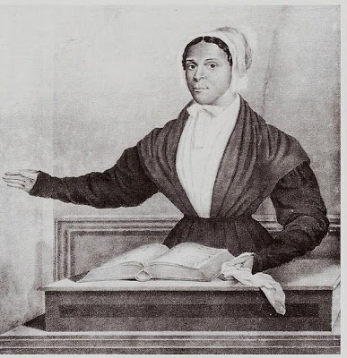
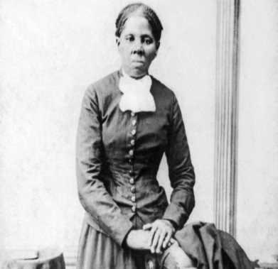
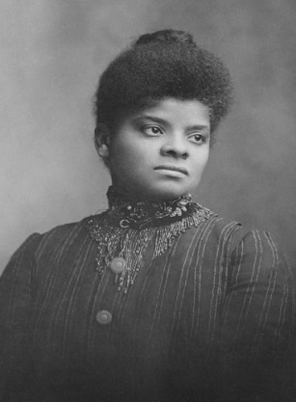
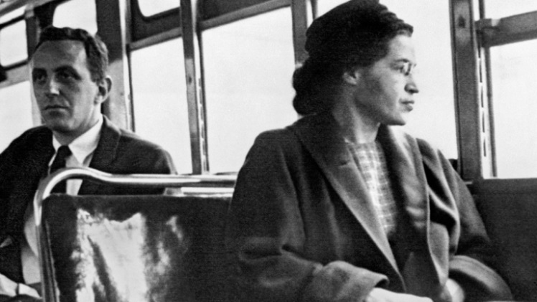
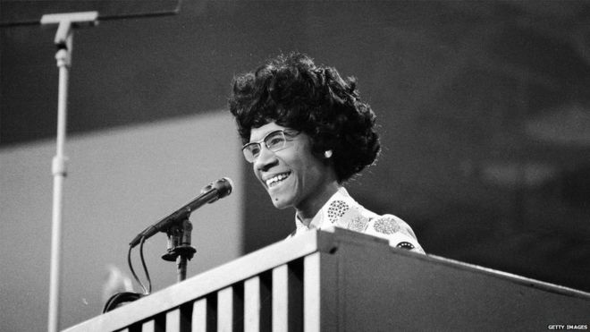
A History of Fighting for Justice
Sojourner Truth, 1826
Juliann Tillman, 1835
Harriet Tubman, 1850s
Ida Wells, 1909
Rosa Parks, 1955
Shirley Chisholm, 1968

Slide 14
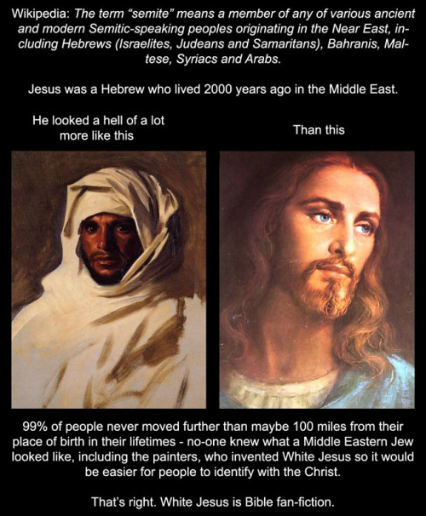
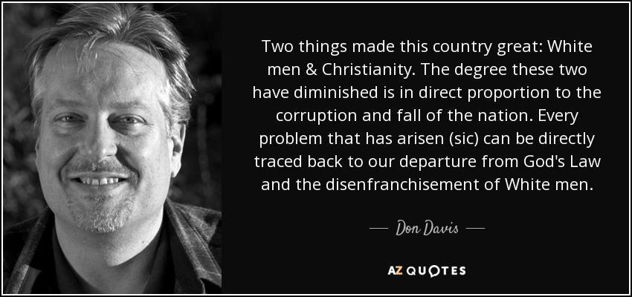
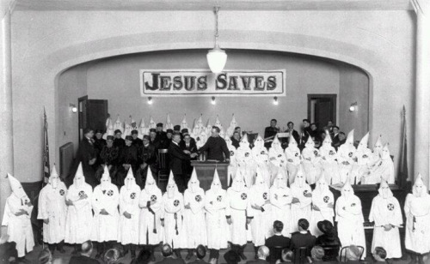
Questioning Whites’ Church History
Notes:
Photo is of Steve Bannon from Breitbart.

Slide 15
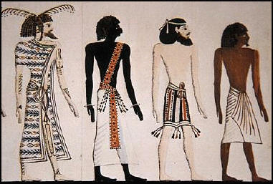

Slide 16
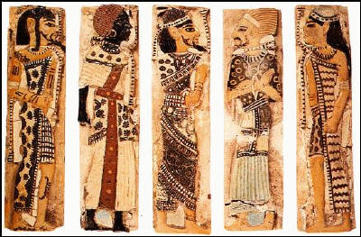

Slide 17
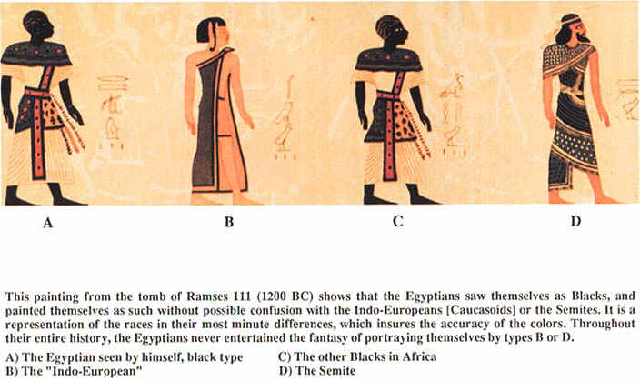

Slide 18
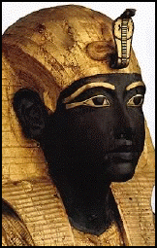

Slide 19
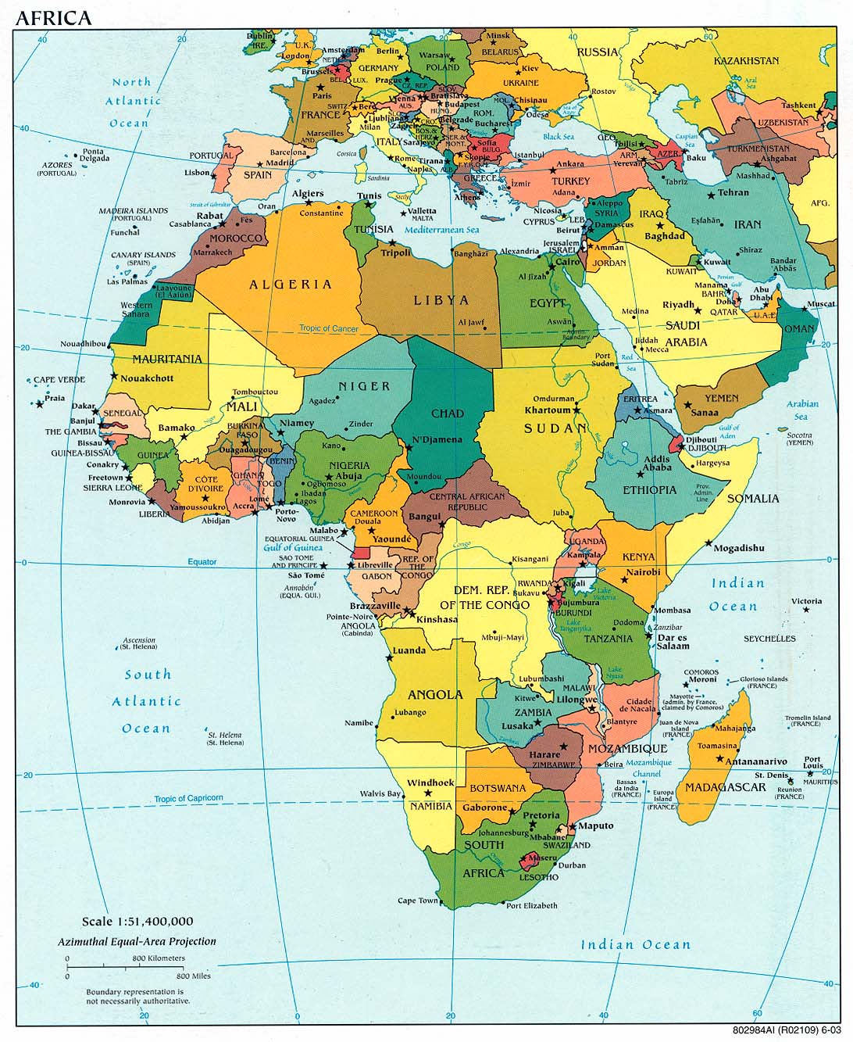

Slide 20


Slide 21


Slide 22


Slide 23


Slide 24


Slide 26



Slide 28


Slide 29


Slide 30


Slide 31


Slide 32


Slide 33


Slide 34
Five Aspects of Liberation Theology
The Christian’s Obligation
Rediscovering the Bible
Opting for the Oppressed
Addressing Structural Sin
Non-violent Stance

Slide 35







1. The Christian’s Obligation
There is real suffering in the world, born of oppression. The Christian must act, for to do nothing is actually to side with the oppressor, the one misusing power. Aren’t we guilty when we see a child abused and do nothing? Aren’t we equally responsible for others who are helpless and suffer injustice?

Slide 36





Slide 37
2. Rediscovering the Bible
Jesus’ Good News
The Exodus Story
Divino Afflante Spiritu, 1943
Comunidades de Base (80,000 +)
Paulo Freire’s Pedagogy of the Oppressed
Carlos Mesters’ Parable of the House
Christianity in Black America

Slide 38
“The Spirit of the Lord is
upon me
Because he has anointed me
to bring good news to the poor.
He has sent me to proclaim
release to the captives
and recovering of sight to the blind,
to let the oppressed go free,
to proclaim the year of the Lord’s favor.”
(Luke 4:18-19)

Slide 39
Then the Lord said, “I have observed the misery of my people who are in Egypt; I have heard their cry on account of their taskmasters. Indeed, I know their sufferings, and I have come down to deliver them from the Egyptians, and to bring them out of that land to a good and broad land, a land flowing with milk and honey. . . . The cry of the Israelites has now come to me; I have also seen how the Egyptians oppress them. So come, I will send you to Pharaoh to bring my people out of Egypt.” (Exodus 3: 7-10)

Slide 40












Slide 41
3. Opting For the Oppressed
Does God have a bias for the poor?
Yes and No.
Poor as victims of injustice
Poor as victims of bad luck
Poor as victims of own sloth or improvidence
The Nature of God as the One who rejects power and dies on the cross in solidarity with those crucified by power structures of the world.

Slide 42








4. Addressing Structural Sin
Income distribution
Incarceration
Educational opportunities

Slide 43


Slide 44


Slide 45

Comparing Black and White Incomes

Slide 46


Slide 47


Slide 48


Slide 49


Slide 50


Slide 51


Slide 52


Slide 53


Slide 54


Slide 55


Slide 56


Slide 57

Education and Income

Slide 58


Slide 59


5. Non-Violent Stance
Starts with the Image of Jesus who Suffers

Slide 60






The Cost of Change

Slide 61
“The Current Crisis in Race Relations”
The non-violent method is not cowardice or stagnant passivity; it does resist evil. While nonaggressive physically, it is dynamically aggressive spiritually.
It does not seek to defeat or humiliate the opponent. The end is redemption and reconciliation.
It attacks the forces of evil rather than the ones caught in those evils. The tension is between justice and injustice.
The method not only avoids external violence, but also internal violence of the spirit. At the center of non-violence stands the principle of love.
A fifth basic fact about non-violent resistance is that it is based on the conviction that the universe is on the side of justice

Slide 62


Social Gospel
Walter Rauschenbusch
Social Principles

Slide 63


Changing Stance of the Church

Slide 64





Controversies with U.S. Government

Slide 65


Slide 66
Quick Bibliography
Robert McAfee Brown, Liberation Theology: An Introductory Guide (Louisville, KY: Westminster/John Knox Press, 1993)
James H. Cone, A Black Theology of Liberation (Philadelphia, PA: J. B. Lippincott Co., 1970)
James H. Cone, For My People:Black Theology and the Black Church (Maryknoll, NY: Orbis, 1984)
James H. Cone, Risks of Faith: The Emergence of a Black Theology of Liberation, 1968-1998 (Boston: Beacon Press, 1999)
Grayraud S. Wilmore and James H. Cone, eds., Black Theology: A Documentary History, 1966-1979 (Maryknoll, NY: Orbis, 1979)

